Slide 1


POLYMORPHISM
Presented by
Mounika Jeela

Slide 2
Contents
Definition
Types of Polymorphism.
Compile time polymorphism and its examples.
Run time polymorphism and its example.
Difference between Compile Time and Run Time Polymorphism.

Slide 3
What is Polymorphism?
Polymorphism is the concept of one entity providing multiple implementations or behaviors. Thus polymorphism is ability of an object to make more than one form.
Polymorphism in Java is a concept by which we can perform a single action in different ways. Polymorphism is derived from 2 Greek words: poly and morphs. The word "poly" means many and "morphs" means forms. So polymorphism means many forms.

Slide 4
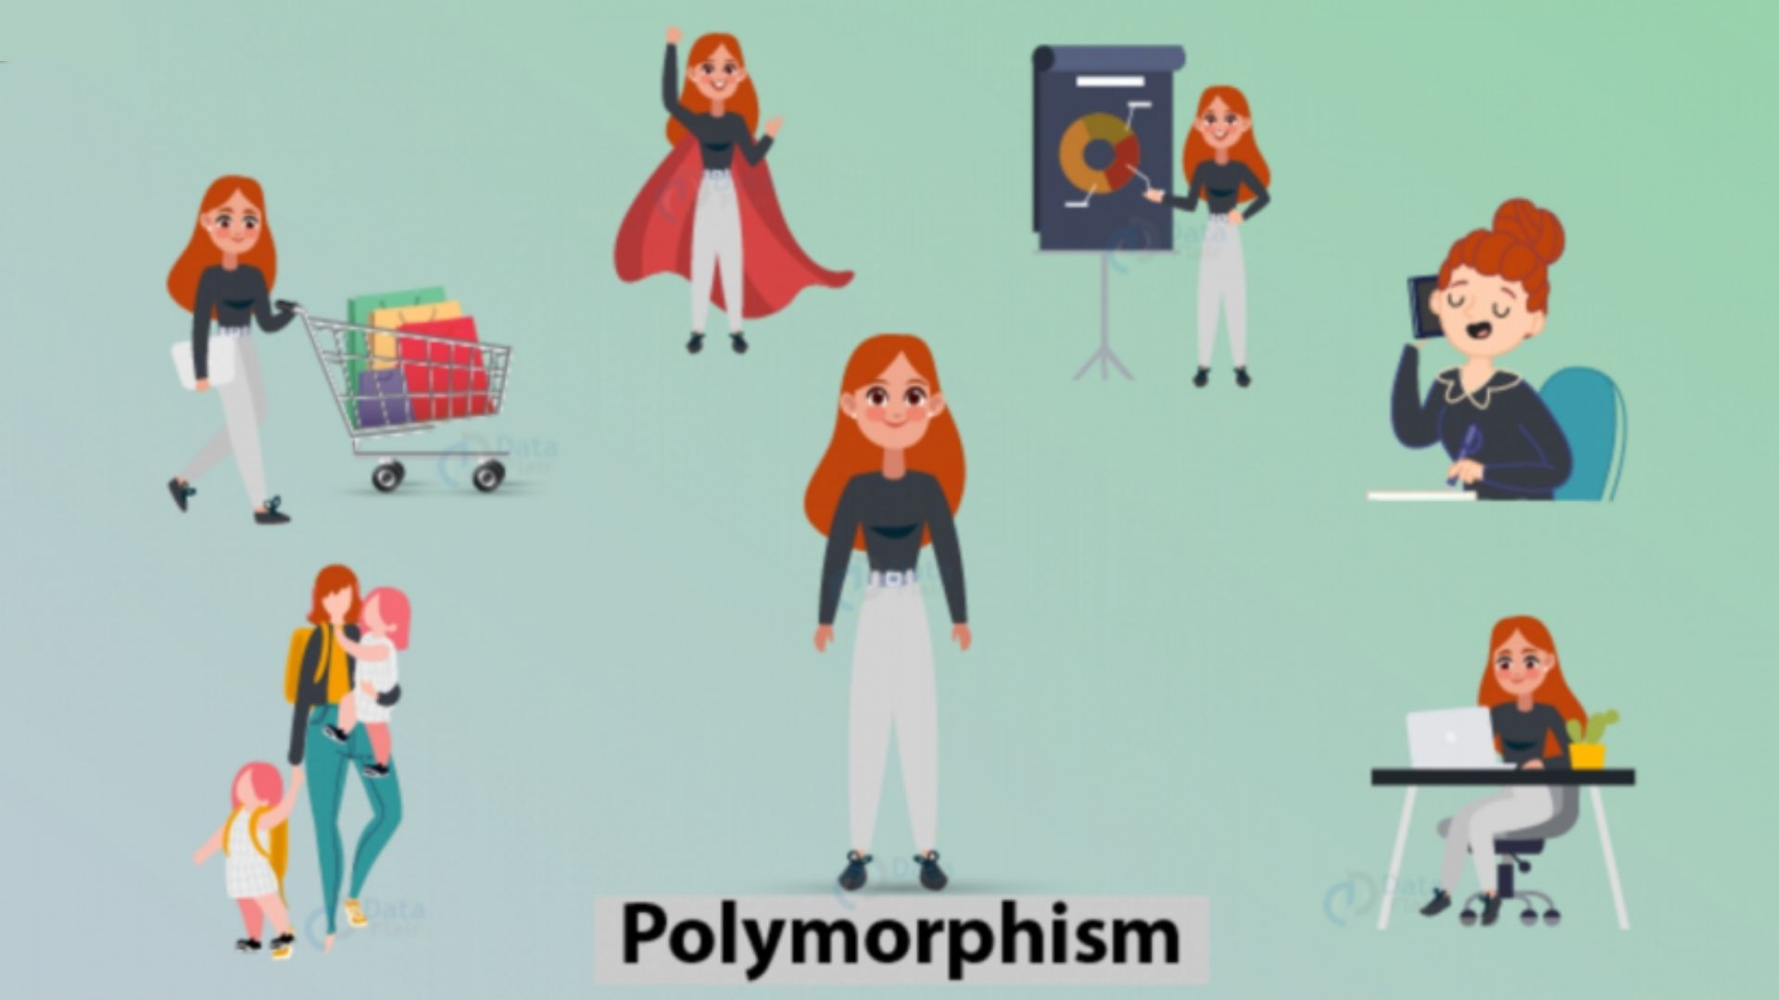
Example :-

Slide 5
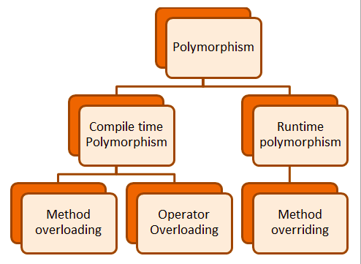
Types of Polymorphism

Slide 6
Compile Time (or) Static Polymorphism Compile-time polymorphism is also known as static polymorphism or early binding. Compile-time polymorphism is a polymorphism that is resolved during the compilation process. Overloading of methods is called through the reference variable of a class. Compile-time polymorphism is achieved by method overloading and operator overloading.

Slide 7
Run Time (or) Dynamic Polymorphism
Runtime polymorphism or Dynamic polymorphism is a process in which a call to an overridden method is resolved at runtime rather than compile-time.
Method Overriding is done when a child or a subclass has a method with the same name, parameters, and return type as the parent or the superclass; then that function overrides the function in the superclass. In simpler terms, if the subclass provides its definition to a method already present in the superclass; then that function in the base class is said to be overridden.

Slide 8
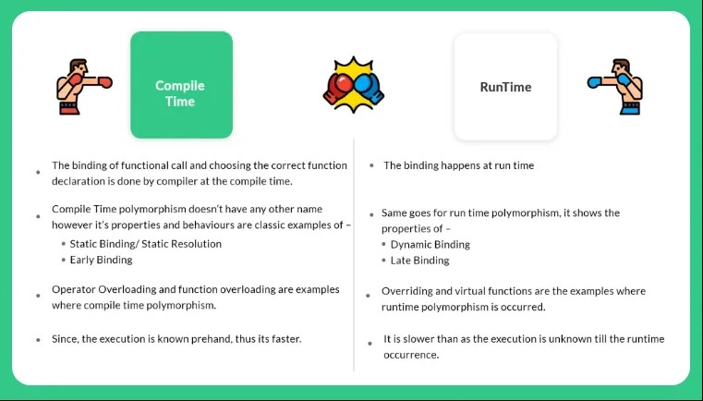
Difference between Compile Time &Run Time Polymorphism

Slide 9
THANK YOU

